Slide 1
Lecture 9
Expectation
Properties of expectation
Bernoulli, Binomial and Poisson Distributions, and their Expectations

Slide 2
Expectation of A Random Variable
E. g. Among the population in a town, 20% have an annual income of 90,000 Yuan, 60% have an annual income of 60,000 Yuan, and the remaining 20% have an annual income of 30,000. What is the average annual income?
E.g. Supply, Inc. is a supplier for Demand, Inc. 10% of the time, it takes Supply, Inc. 9 days to fill the orders of Demand, Inc.; 50% of the time, it takes 10 days; 40% of the time, it takes 11 days. On average, what is the number of days it takes Supply, Inc. to fill the orders?

Slide 3
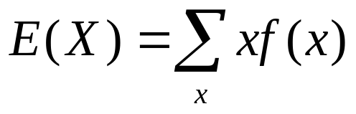
Suppose X has a discrete distribution with p.f. f. The expectation (expected value, mean) of X, is a number defined as:
Interpretation: weighted average with probabilities being weights; average value of X over a large number of repetitions; the most common measure of central location for the distribution of X.

Slide 4
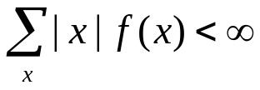
If there is an infinite sequence of different possible values of X, then the summation consists of an infinite series of terms, and may not converge for a given p.f.
It is said that E(X) exists if and only if the summation is absolutely convergent, i.e.,

Slide 5
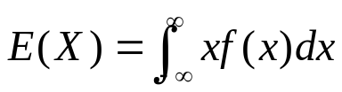
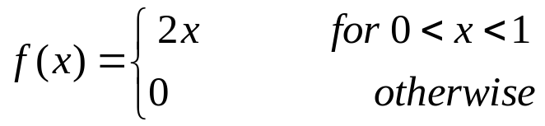
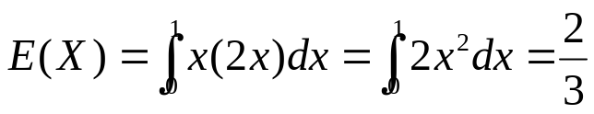
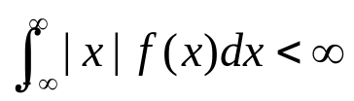
Expection for Continuous Distributions
Suppose X has a continuous distribution with p.d.f. f, then the expectation E(X) is defined as:
Example 4.1.2 Suppose that the p.d.f. of X is
Then
It is said that E(X) exists if and only if the integral is absolutely convergent, i.e.

Slide 6
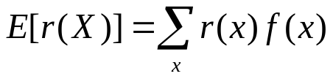
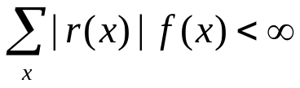
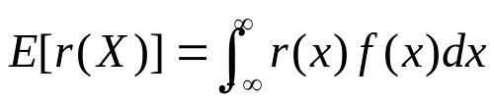
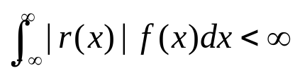
The Expectation of A Function
The value of E[r(X)] can be calculated as:
        (X has a discrete dist.)
if
or (X has a continuous dist.)
if
Note: the result would be the same if we first derive the distribution of Y=r(X), and then calculate E(Y).

Slide 7

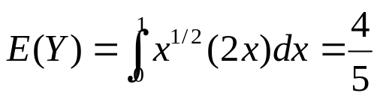
Example
Suppose that the p.d.f. of X is:
Suppose . Then

Slide 8
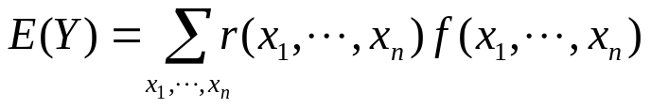

Functions of Several Random Variables
Suppose that the joint p.f. or p.d.f. f(x1,...,xn) of n random variables X1,...,Xn is given, and Y=r(X1,...,Xn). The expected value E(Y) can be determined directly through
or

Slide 9



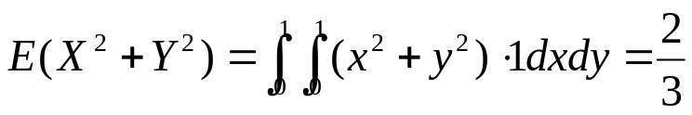
Example
Suppose a point (X,Y) is chosen at random from the square S containing all points (x,y) such that and . What is the expected value of ?

Slide 10
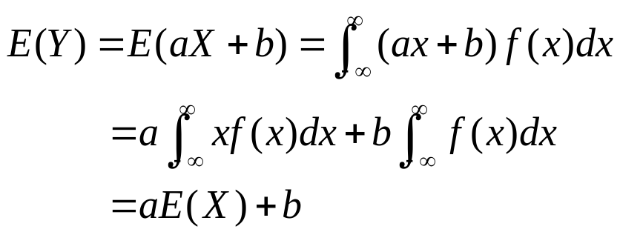
Properties of Expectations
Suppose E(X) exists.
Theorem. If Y=aX+b, where a and b are constants, then E(Y)=aE(X)+b.
Proof. For convenience, suppose X has a continuous distribution.

Slide 11
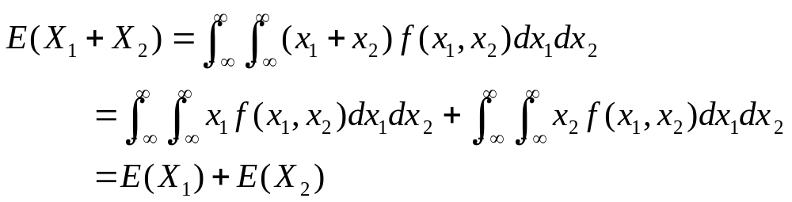
Theorem. If X1,...,Xn are n random variables such that each expectation E(Xi) exists (i=1,...,n), then
E(X1+...+Xn)=E(X1)+...+E(Xn)
Proof. Suppose first n=2, and X1 and X2 have a continuous joint distribution with joint p.d.f. f. Then
The theorem can be established for any positive integer n by induction.

Slide 12
From the previous two theorems, for any constants a1,...,an and b,
  E(a1X1+...+anXn+b)=a1E(X1)+...+anE(Xn)+b

Slide 13
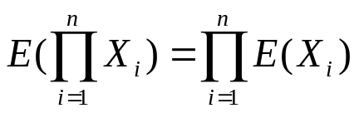
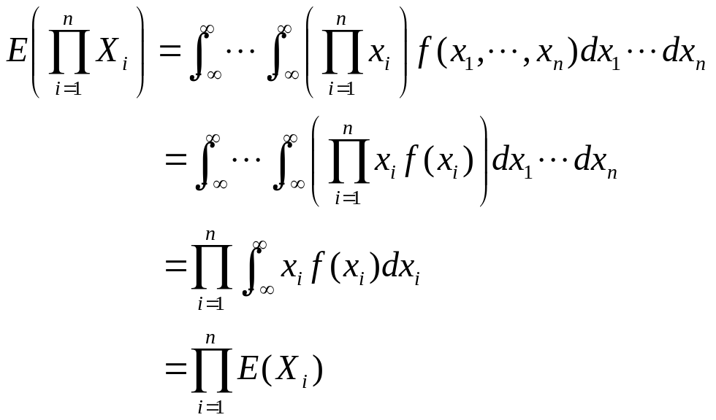
Expectation of a Product
Theorem. If X1,...,Xn are n independent random variables such that each expectation E(Xi) exists (i=1,...,n), then
Proof. Suppose X1,...,Xn have a continuous joint distribution with joint p.d.f. f,

Slide 14
Example. Sampling without Replacement
A box contains red balls and blue balls. The proportion of red balls in the box is p. n balls are selected from the box at random without replacement. Let X denote the number of red balls that are selected. What is the value of E(X)?

Slide 15
  For i=1,...,n, let Xi=1 if the ith ball selected is red, and let Xi=0 if the ith ball selected is blue. Then X=X1+...+Xn.
  Since the n balls are selected without replacement, the random variables X1,...,Xn are dependent.
  However, the marginal distribution of each Xi can be derived.
    Imagine all the balls are arranged in some order in the box. The first n balls in this arrangement are selected.
    The probability that the ith ball in the arrangement will be red is simply p. Thus, for i=1,...,n,
    Pr(Xi=1)=p Pr(Xi=0)=1-p
    So E(Xi)=1(p)+0(1-p)=p
  So E(X)=E(X1)+...+E(Xn)=np.

Slide 16


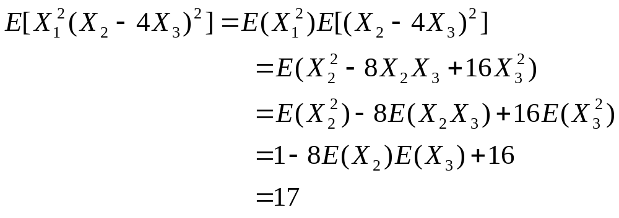
Example
Suppose X1, X2 and X3 are independent random variables such that E(Xi)=0 and
E( )=1 for i=1,2,3. What is the value of
E[ ]?

Slide 17
Bernoulli and Binomial Distributions
Many experiments result in dichotomous responses --- that is, responses for which there exist two possible alternatives, such as Yes-No, Pass-Fail, Defective-Nondefective, or Male-Female.
The experiment is often conducted for a fixed number n of times, and we are interested in the number X of times that one of the two possible outcomes occurs.

Slide 18
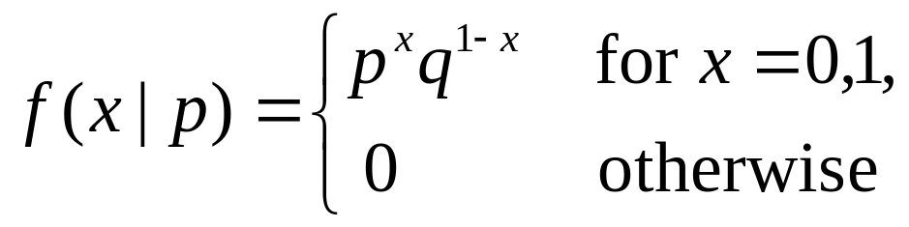
The Bernoulli Distribution
A random variable X has a Bernoulli distribution with parameter p if X can take only the values 0 and 1 with probabilities:
  Pr(X=1)=p and Pr(X=0)=q=1-p.
The p.f. of X can be written as:
E(X)=p

Slide 19
Bernoulli Trials
If n random variables X1,...,Xn are i.i.d., and each random variable Xi has a Bernoulli distribution with parameter p, then X1,...,Xn form n Bernoulli trials with parameter p.
  E.g. 1. n people are randomly chosen from certain population. Xi=1 if the ith person is female, and Xi=0 if the ith person is male.
  E.g. 2. Suppose 10% of the items produced by a machine are defective, and n items are selected at random. Xi=1 if the ith item is defective and Xi=0 if it is non-defective.

Slide 20
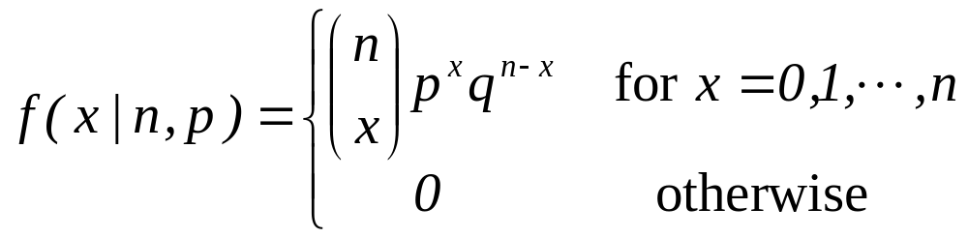
The Binomial Distribution
If the random variables X1,...,Xn form n Bernoulli trials with parameter p, and if X= X1+…+Xn, then X has a Binomial distribution with parameters n and p.
The p.f. for a random variable having binomial distribution with parameters n and p is
E(X)=np

Slide 21
Binomial or not?
Example 1: You randomly select 3 bonds out of a possible 10 for an investment portfolio. Unknown to you, 8 of the 10 will maintain their present value, and the other 2 will lose value due to a change in their ratings. Let x be the number of 3 bonds you select that lose value.
Example 2: Suppose a company develops a new diet soda and then conducts test preference survey in which 100 randomly chosen consumers state their preferences among the new soda and the two leading sellers. Let x be the number of the 100 who choose the new brand over the two others.

Slide 22
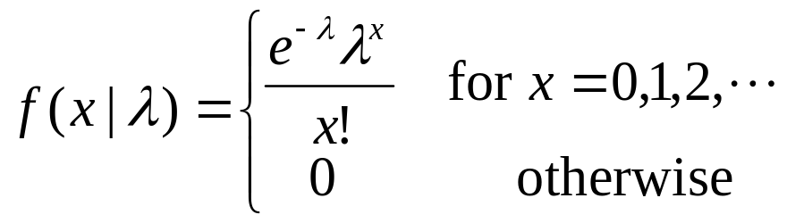
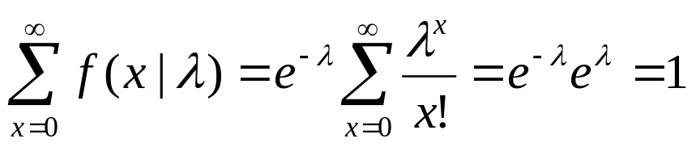
The Poisson Distribution
A nonnegative random variable X has a Poisson distribution with mean λ (λ>0) if the p.f. of X is as follows:
Note:

Slide 23
The Poisson distribution is often used to describe the total number of occurrences of some phenomenon during a fixed period of time (or within a fixed region of space).
  The number of deaths due to horse kick in the Prussian army.
  The number of fans of Weibo accounts.
  The number of requests for individual documents on a web server.

Slide 24
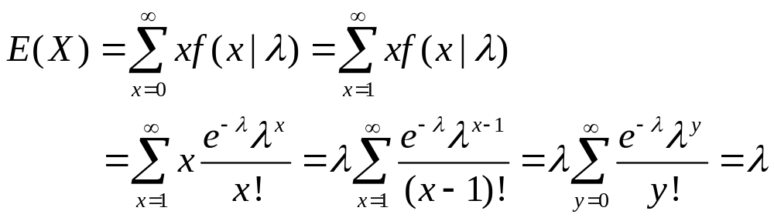
Expectation

